Slide 1
Sources
Buckscore (BSD)
Aging Deer on the Hoof, Jawbone Aging, and Cementum Annuli
CamperJim.Tripod (CPJ)
How To Age A White-Tailed Deer
GrowingDeer.TV (GDT)
Shed Antler Hunting and How to Age Deer with Tooth Wear
Land Grant Press, Clemson University (LGP)
A key for aging white-tailed deer using tooth replacement
MeatEater (MTE)
(video) Become a Jawbone Aging Expert with NDA’s Matt Ross | NDA Beer & Deer Webinar
Mossy Oak Game Keeper (MOG)
(blog) Aging Deer Using Jawbone Analysis
National Deer Association (NDA)
Become a Jawbone Aging Expert with NDA’s Matt Ross | NDA Beer & Deer Webinar
Which deer aging technique is more accurate, jawbone or cementum?
A Photo Gallery of Jawbones From Extremely Old Deer
Pennsylvania Game Commission (PGC)
(video) Deer Aging.mov
Purdue Extension (PRD)
Age Determination in White-Tailed Deer FNR-508_WV
QDMA:
(video) White-tailed Deer Jawbone Aging: Part 1 – Tooth Replacement
(video) White-tailed Deer Jawbone Aging: Part 2 – Tooth Wear
(video) White-tailed Deer Jawbone Aging: Part 3 – Quiz
(poster) Jawbone Removal and Aging
Texas Parks & Wildlife (TPW):
A Guide To Age Determination of White-Tailed Deer
Three Rivers Land Trust (TRLT)
(video) How to Age a Deer
University of Connecticut (UCN)
How Economics Nearly Drove New England's White-Tailed Deer to Extinction
University of Wisconsin-Madison (UWD)
Deer aging (library image)
Virginia Forest Landowners Education Program (VFL)
(video) Fifteen Minutes In The Forest - How To Age Jawbones of White-tailed Deer
Wildlife Enterprises (WLE)
(video) AGING WHITE TAILED DEER thru TOOTH WEAR Video 1
Whitetail Hunting . Info (WTH)
(blog) Deer Age: Aging Whitetail Deer By The Teeth

Slide 2
Rules
Toofers: Adults will have six adult teeth: 3 premolar + 3 molars
0.5:
Fawns: < 6 teeth
1.5:
6 teeth w/ a temporary 3-part premolar in the third position
2.5:
On the 4th tooth, if the dentine (dark material) is NOT twice as wide as the enamel (white) on the upper crust
19-21 months:
Replacement process of first 3 teeth
3.5:
On the 4th tooth, is the dentine twice as wide as the enamel? Yes.
On the 5th tooth, is the dentine twice as wide as the enamel? No.
4.5:
On the 4th tooth, is the dentine twice as wide as the enamel? Yes.
On the 5th tooth, is the dentine twice as wide as the enamel? Yes.
On the 6th tooth, is the dentine twice as wide as the enamel? No.
5.5:
On the 4th tooth, is the dentine twice as wide as the enamel? Yes.
On the 5th tooth, is the dentine twice as wide as the enamel? Yes.
On the 6th tooth, is the dentine twice as wide as the enamel? Yes.
6.5:
Is dentine twice as wide as enamel on all of the molars? Yes. Go to tooth 4.
Is the 4th tooth starting to dish or flatten? Yes

Slide 3
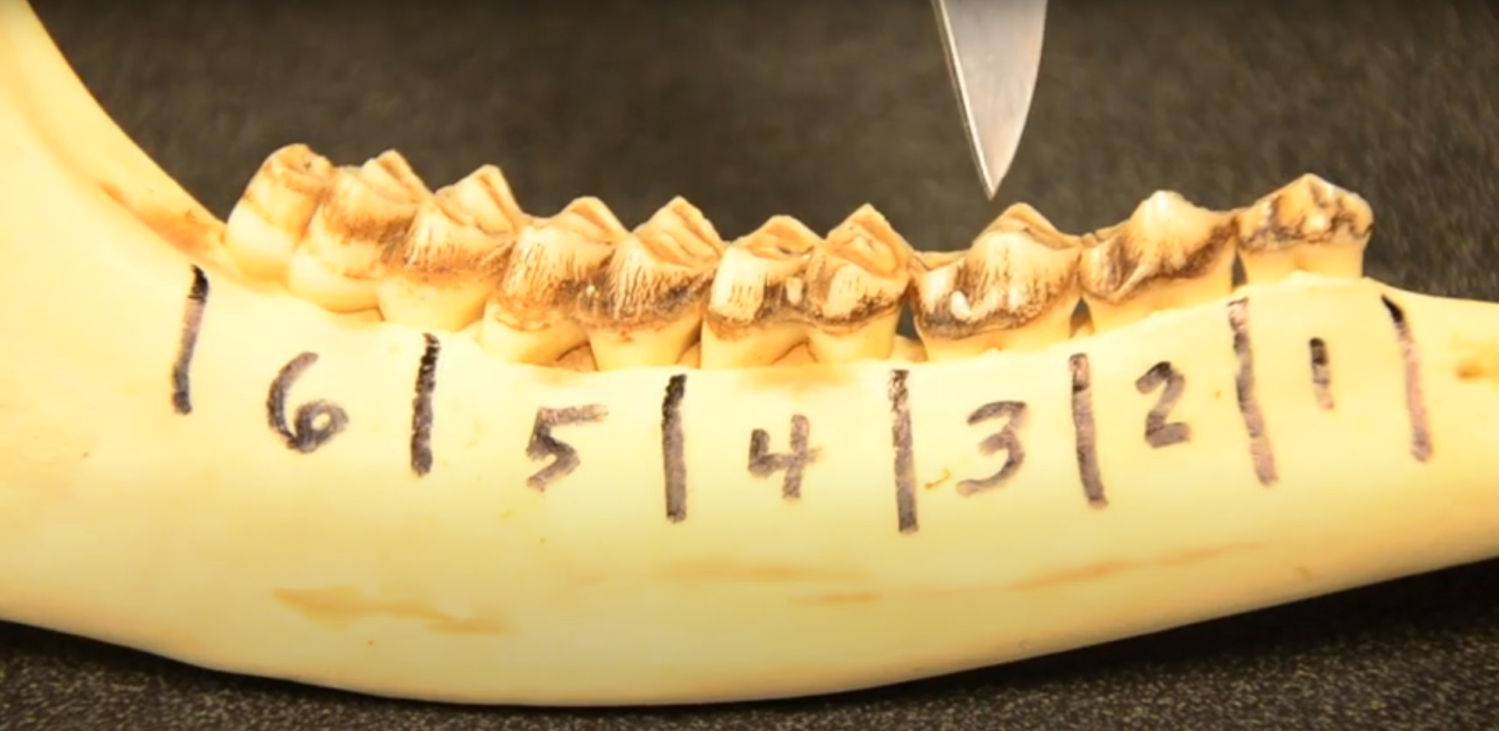
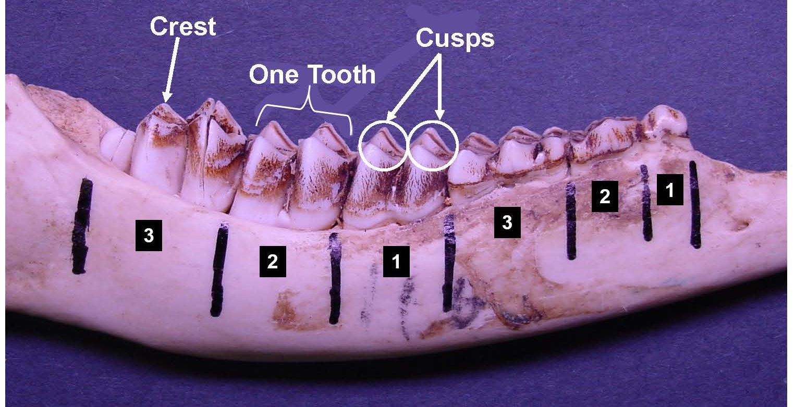
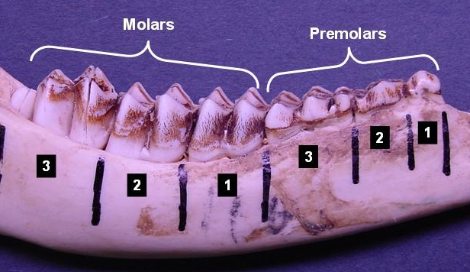
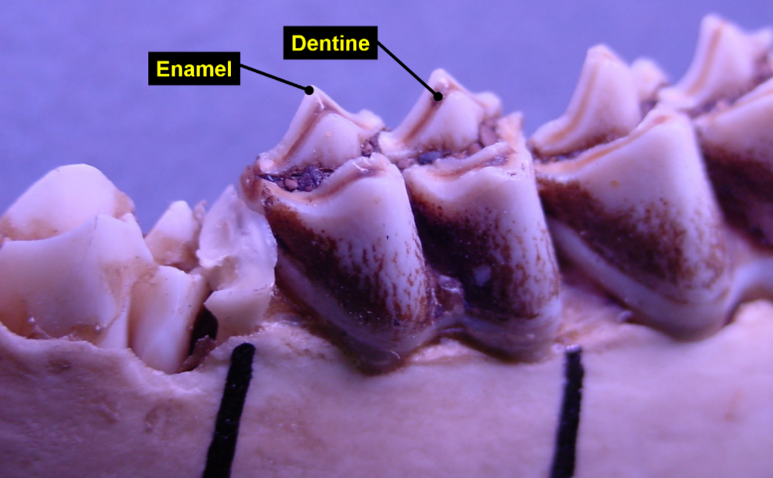
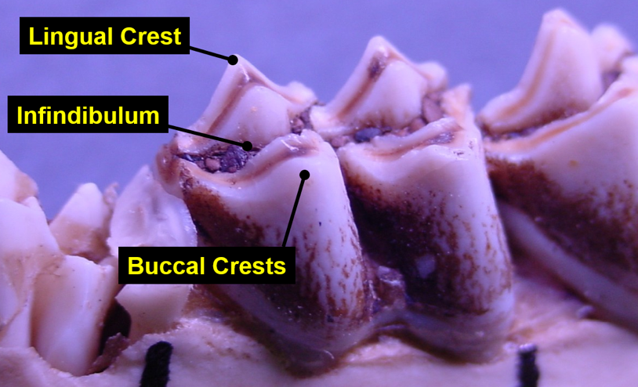
Geometry

Slide 4
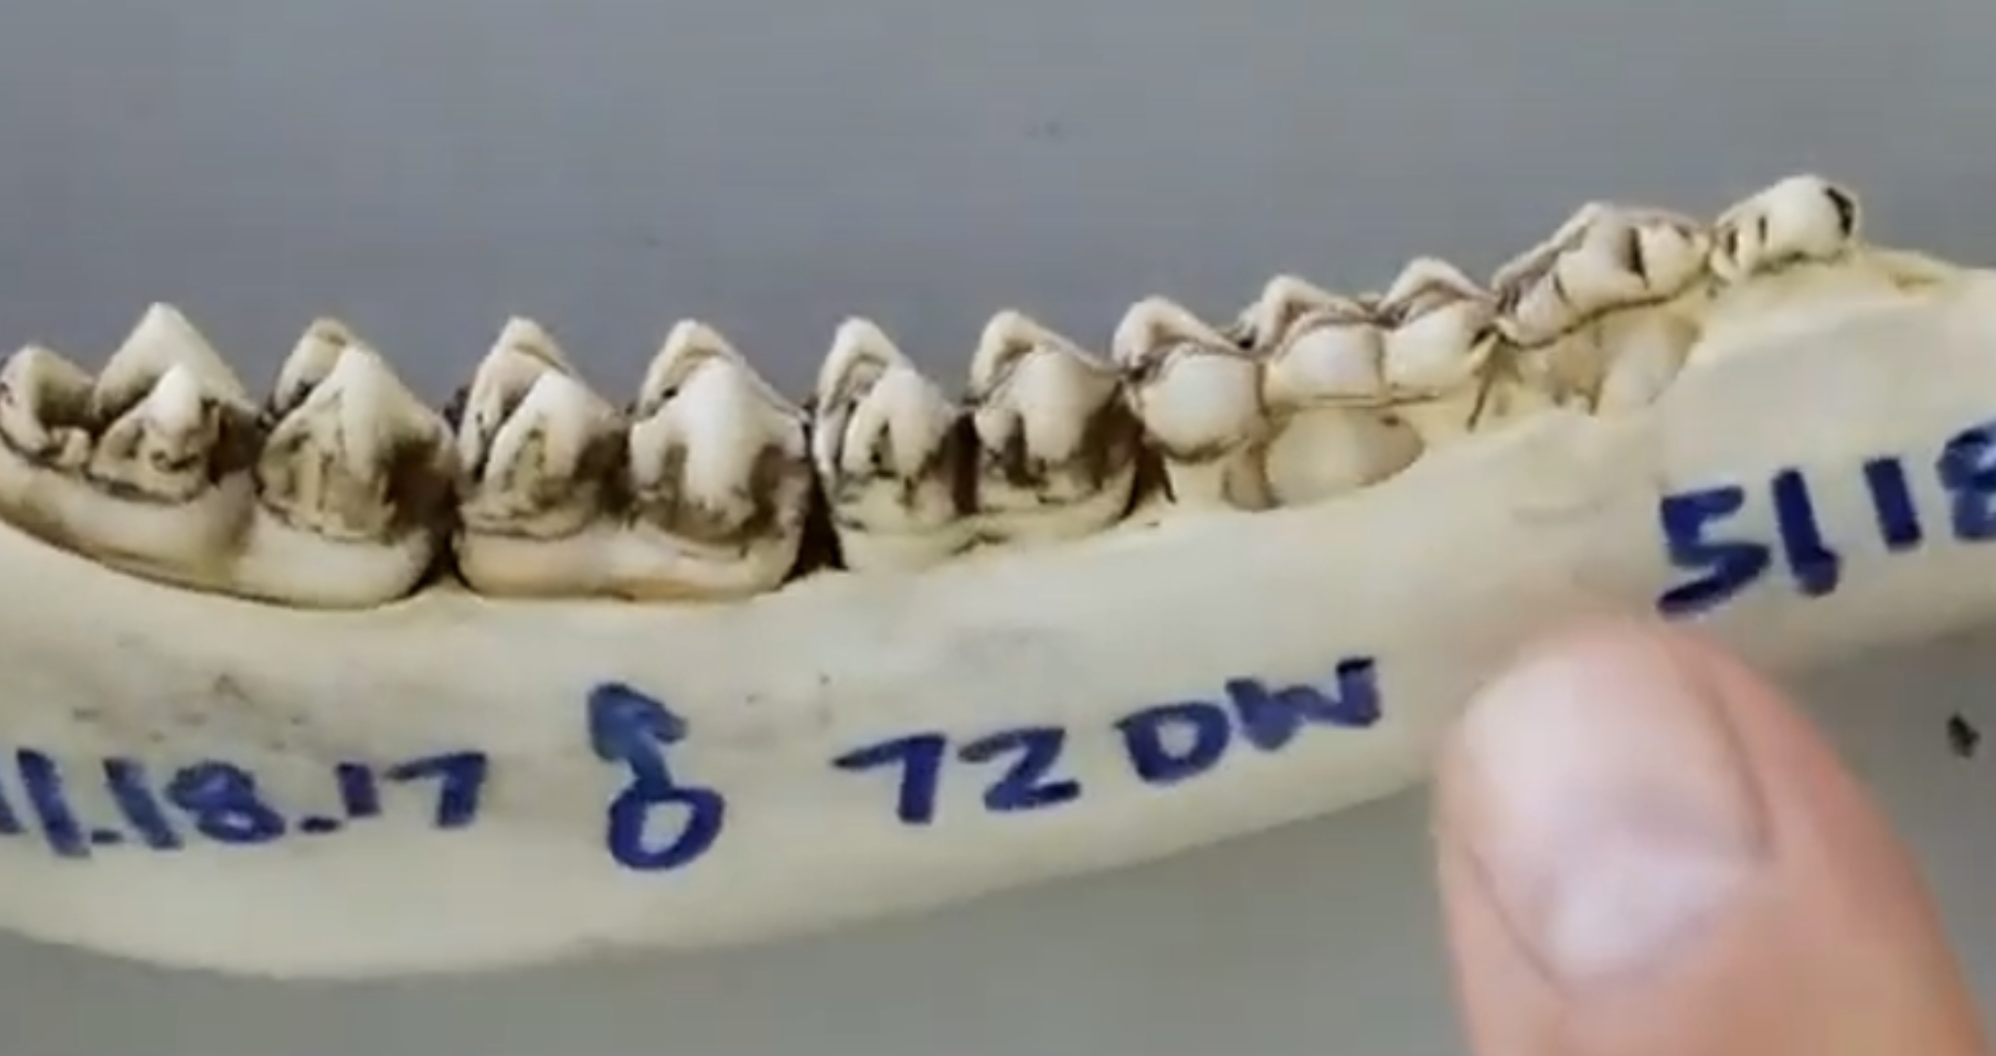
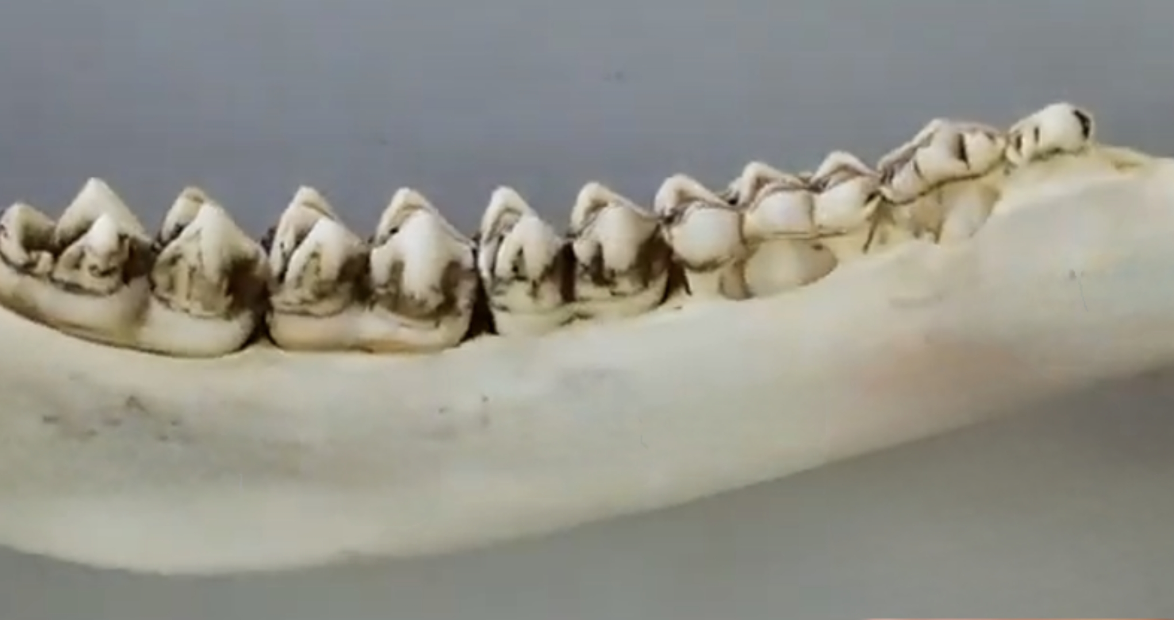

Slide 5
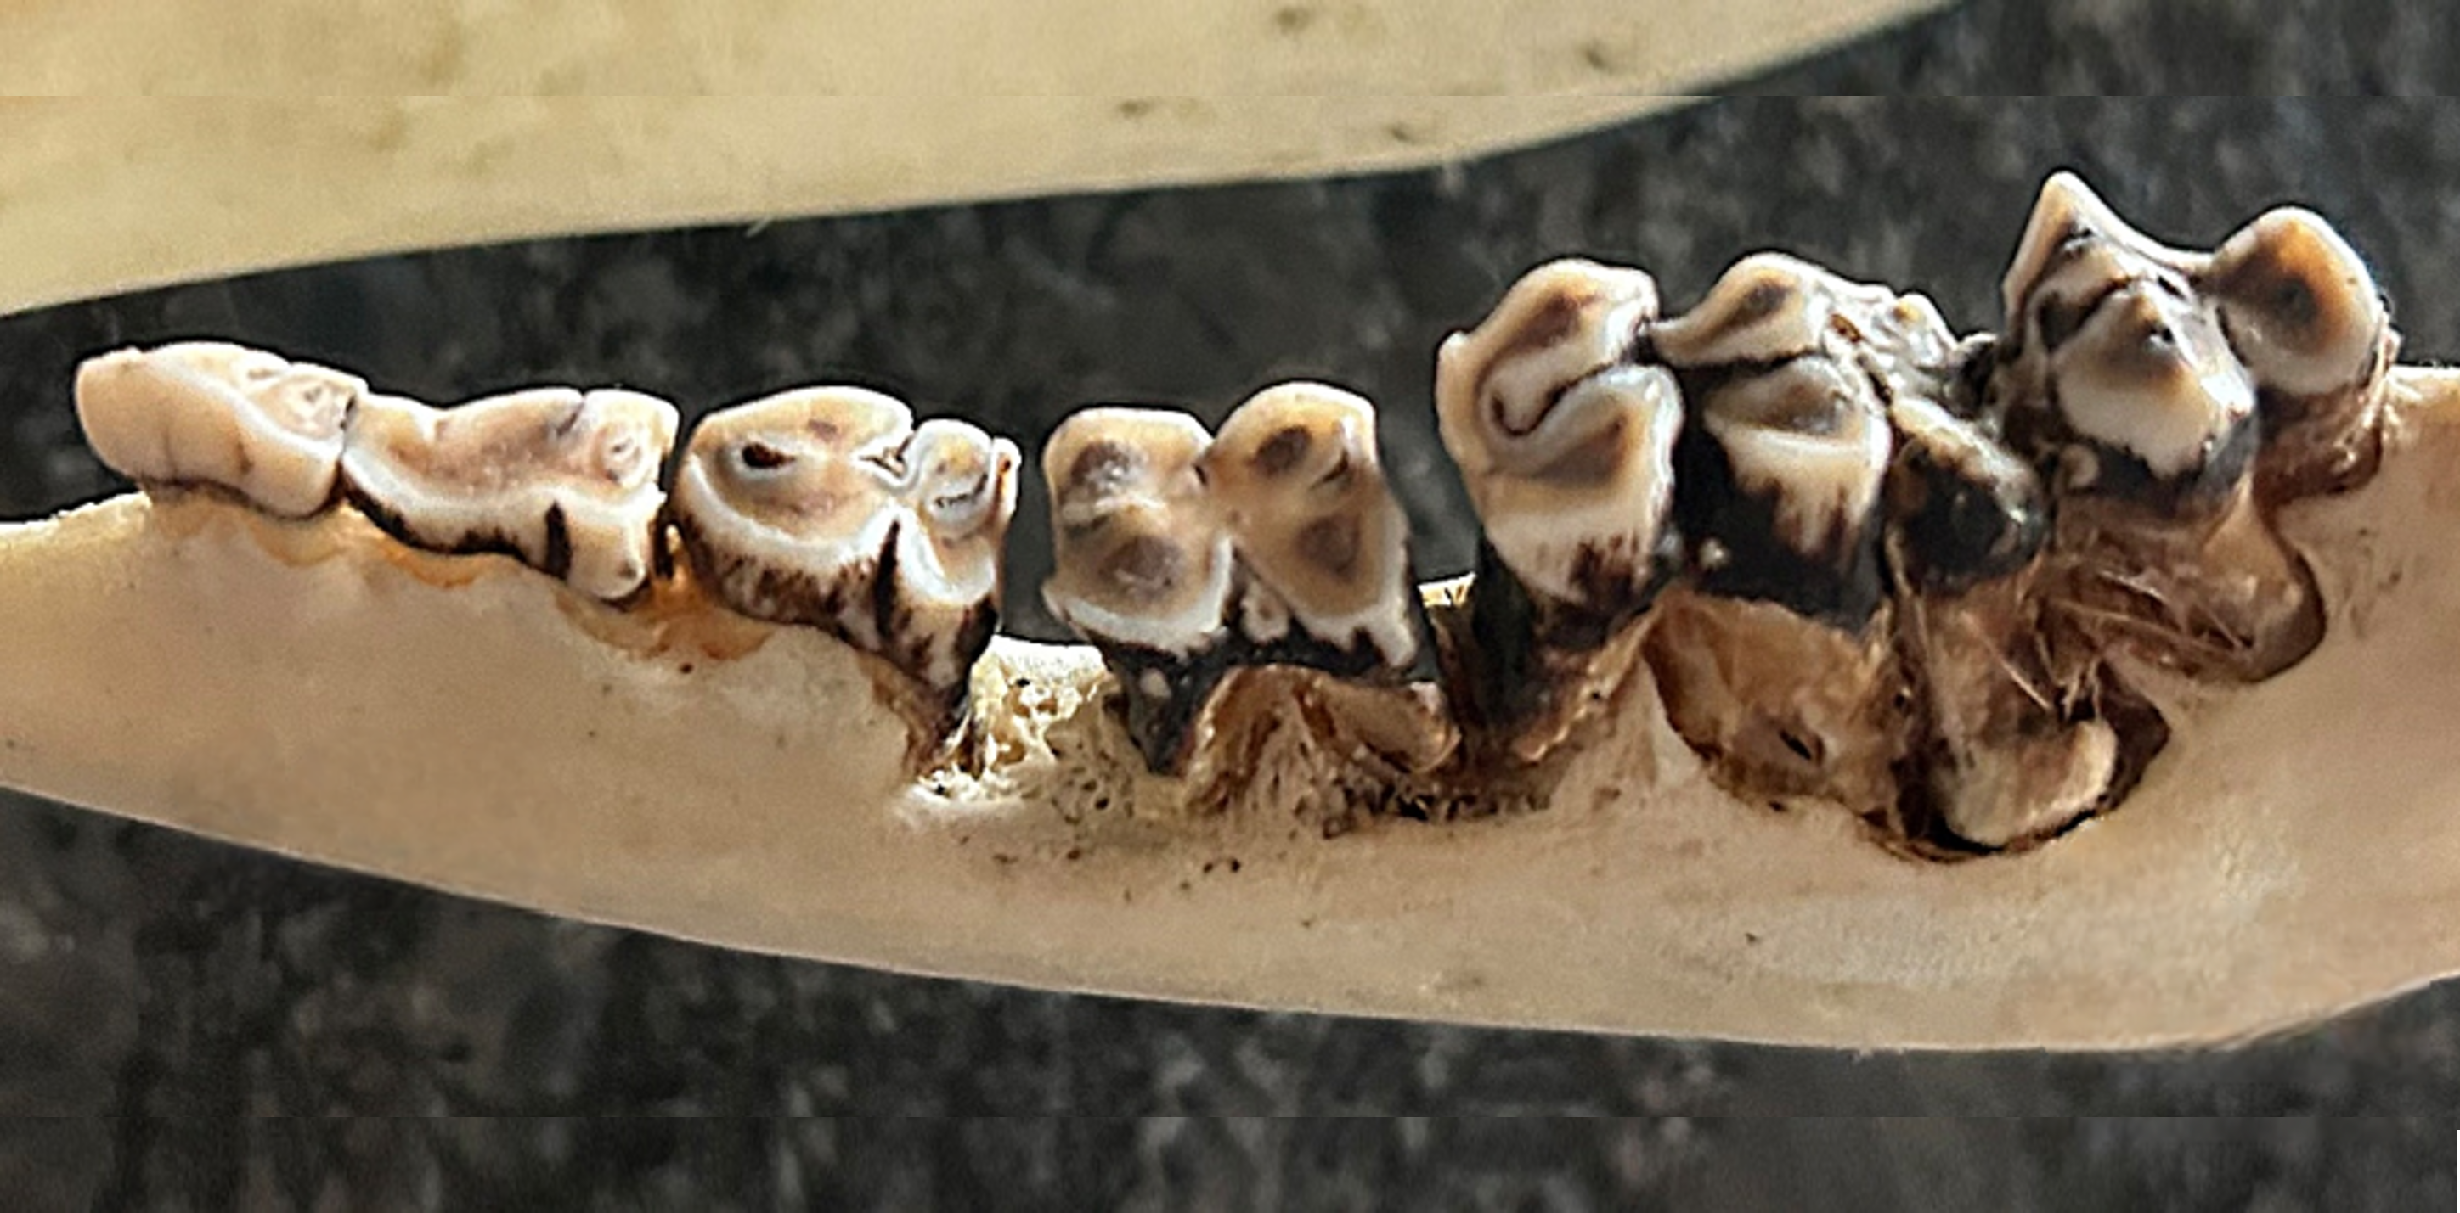
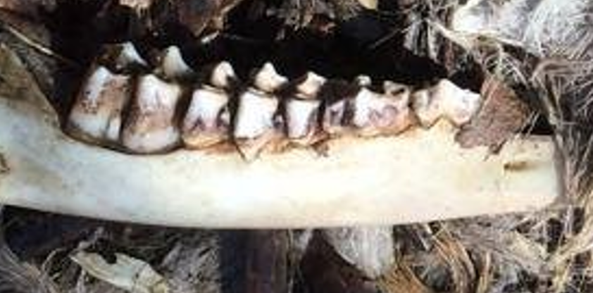
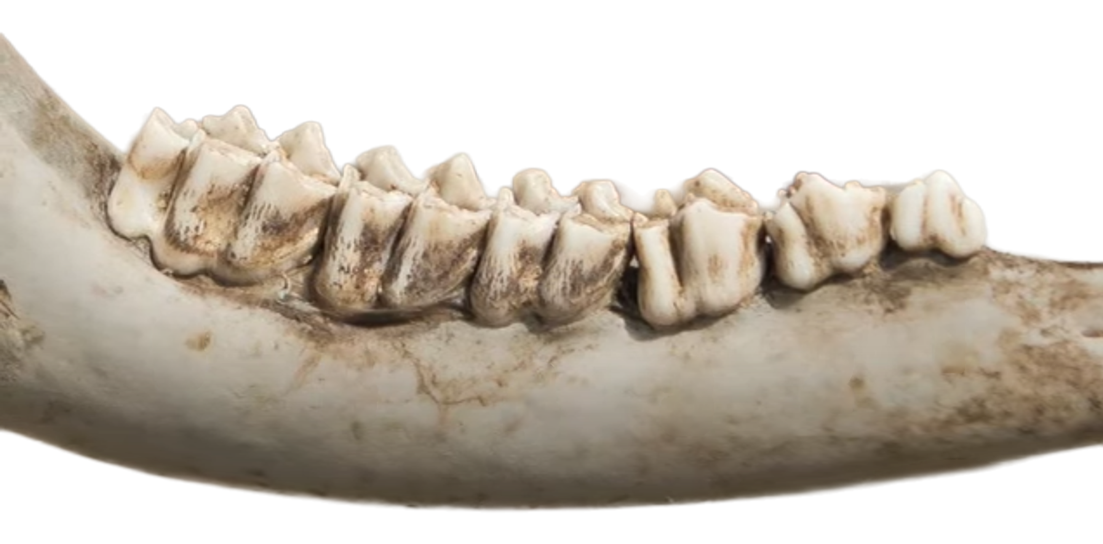
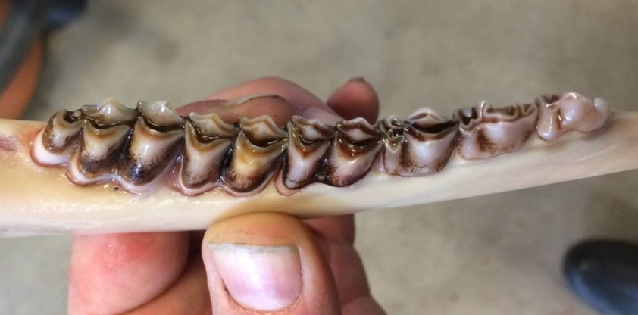
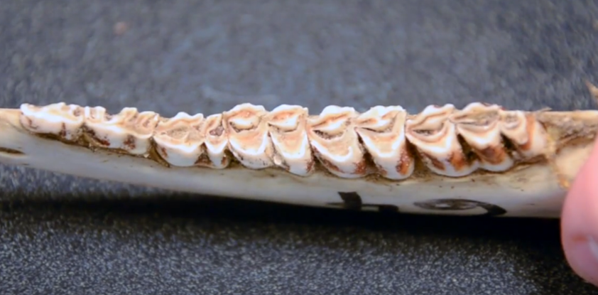
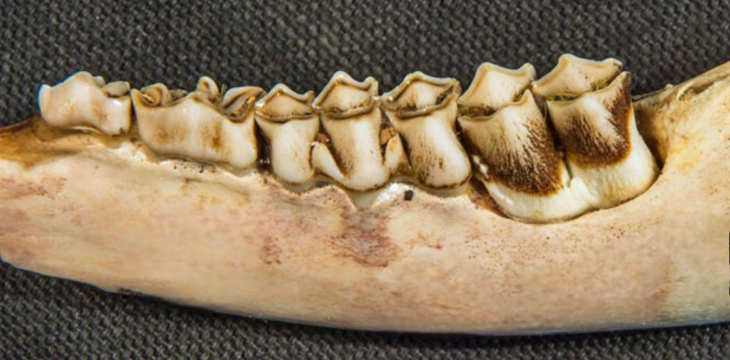
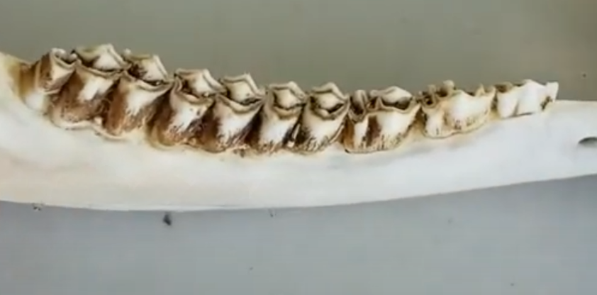

Slide 6
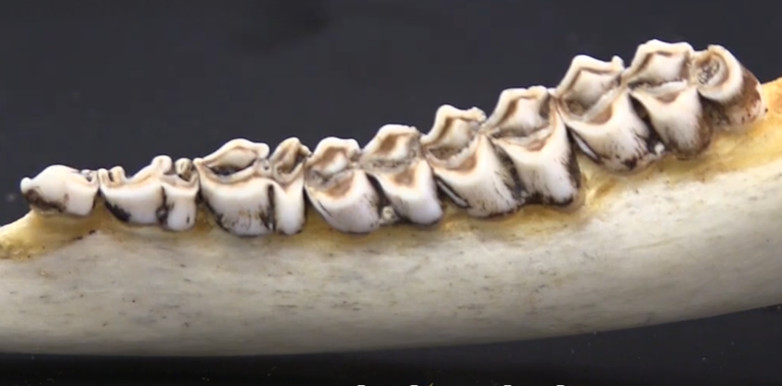






Cusp
Crest
Enamel
Dentine
$$P_{1}$$
$$P_{2}$$
$$P_{3}$$
$$M_{1}$$
$$M_{2}$$
$$M_{3}$$

Slide 7
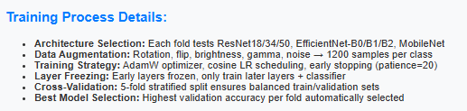
c
Fold 1
CV Split 1
Train: ~155
Validation: ~39
Data Augmentation
~1200 samples / class (Balanced)
Model Training
EfficientNet-B2
80 Epochs
Fold 2
CV Split 2
Train: ~155
Validation: ~39
Data Augmentation
~1200 samples / class (Balanced)
Model Training
EfficientNet-B0
80 Epochs
Processed Data
243 Jaw Images + Ages (6 age classes)
Train/Test Split
80% Train, 20% Test
Training Data
Fold 3
CV Split 3
Train: ~155
Validation: ~39
Data Augmentation
~1200 samples / class (Balanced)
Model Training
EfficientNet-B0
80 Epochs
Fold 4
CV Split 4
Train: ~155
Validation: ~39
Data Augmentation
~1200 samples / class (Balanced)
Model Training
EfficientNet-B2
80 Epochs
Test Data
Fold 5
CV Split 5
Train: ~155
Validation: ~39
Data Augmentation
~1200 samples / class (Balanced)
Model Training
EfficientNet-B0
80 Epochs
Final Evaluation
Ensemble Model
5 Trained Models,
CV Score Weighted

Slide 8
Efficientet-B2
Model 1
Fold 1
CV: 92.3%
Model 1 TTA
(Original + Flip) → Avg. prediction
EfficientNet-B0
Model 2
Fold 2
CV: 87.2%
Model 2 TTA
(Original + Flip) → Avg. prediction
Original
image
Processed Image
224 x 448 x 3
Deer jawbone image
EfficientNet-B0
Model 3
Fold 3
CV: 94.9%
Model 3 TTA
(Original + Flip) → Avg. prediction
Ensemble Aggregation
Weighted average of 5 TTA predictions
Final Prediction
Age Class & Confidence Score
Horizontally
flipped image
EfficientNet-B2
Model 4
Fold 4
CV: 89.7%
Model 4 TTA
(Original + Flip) → Avg. prediction
EfficientNet-B0
Model 5
Fold 5
CV: 89.5%
Model 5 TTA
(Original + Flip) → Avg. prediction

Slide 9
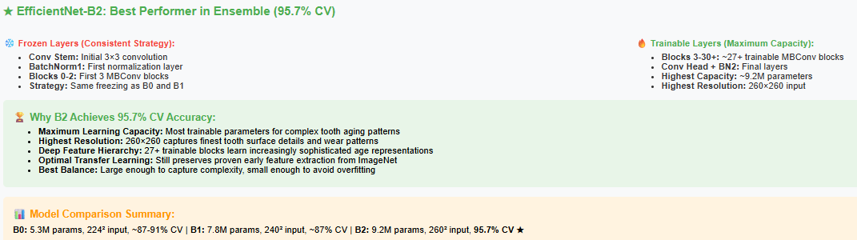
Input
RGB Image
Stem Conv
3x3 convolution, stride=2
Block 0
MBConv1
Block 1
MBConv6
Block 2
MBConv6
Head + Classifier
Conv + GAP + FC
Block 6
MBConv6
Block 5
MBConv6
Block 4
MBConv6
Block 3
MBConv6
Frozen layer
Trainable layer

Slide 10
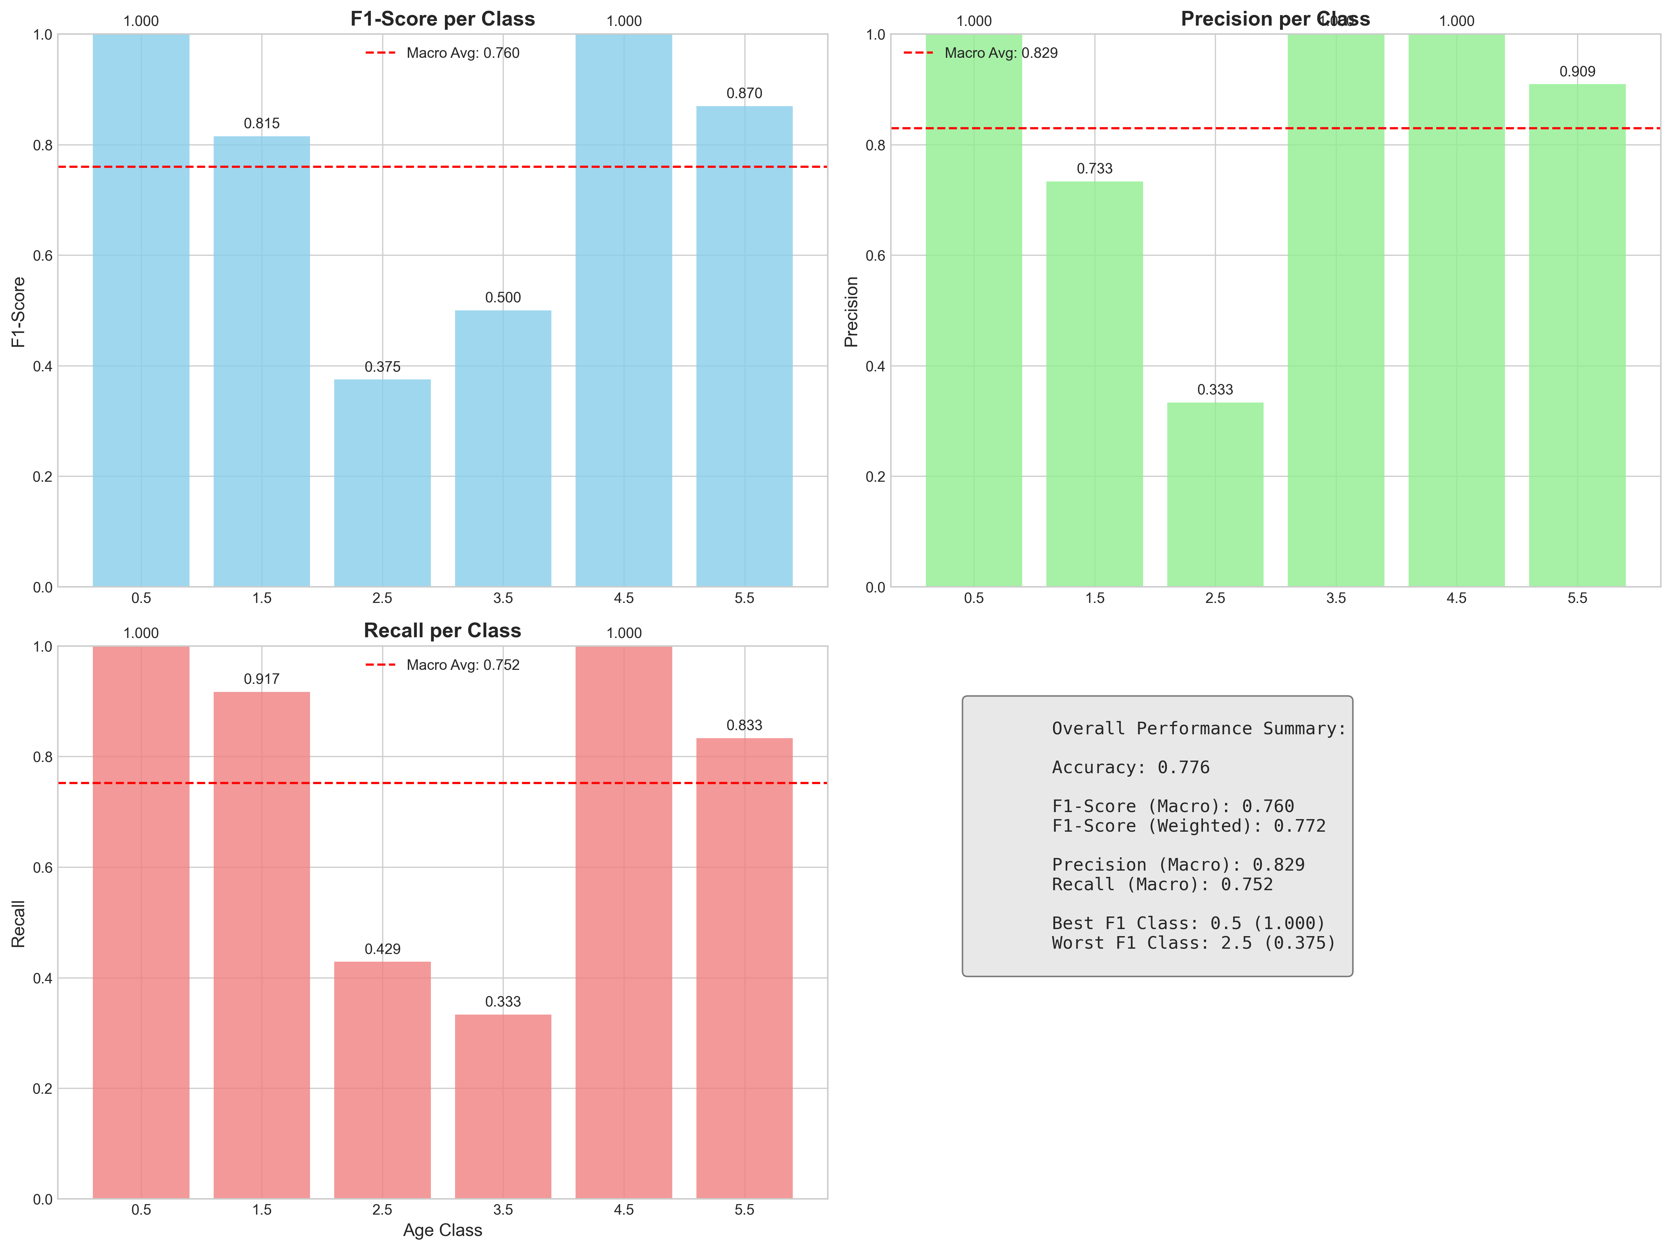
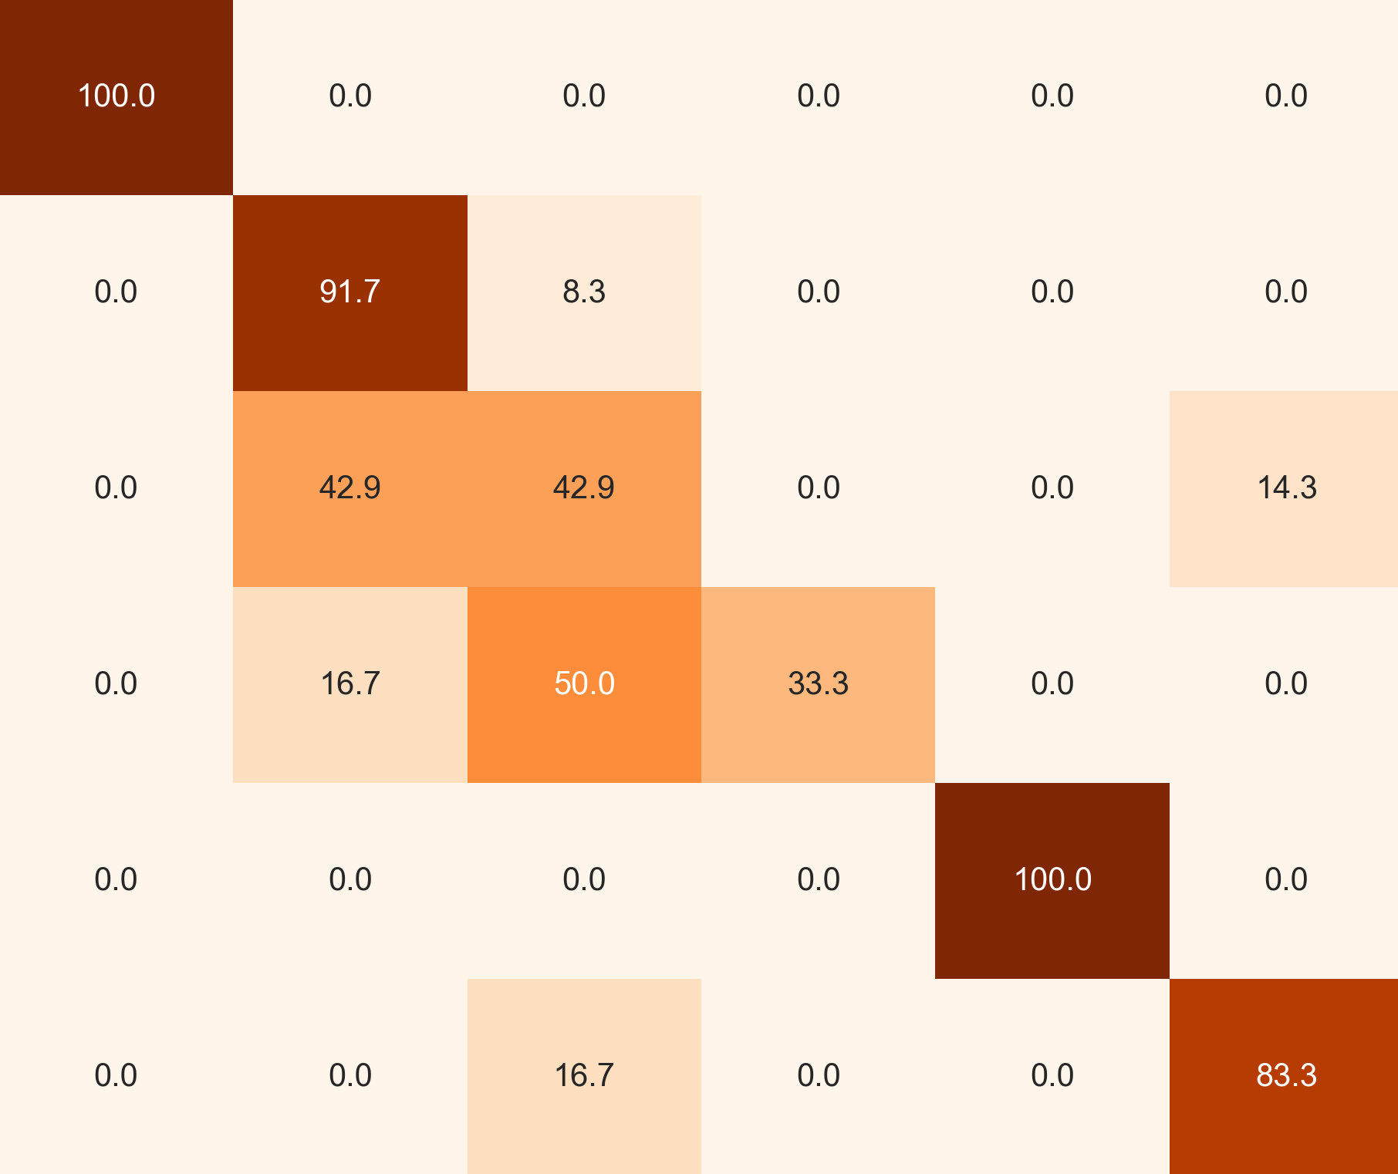
F1 score per class
Ensemble Confusion Matrix
1.0
1.000
1.000
0.870
0.5
100.0
0.0
0.0
0.0
0.0
0.0
0.8
0.815
Macro average: 0.760
1.5
0.0
91.7
8.3
0.0
0.0
0.0
0.6
2.5
0.0
42.9
42.9
0.0
0.0
14.3
F1 Score
0.500
True Age [years]
0.4
0.375
3.5
0.0
16.7
50.0
33.3
0.0
0.0
4.5
0.0
0.0
0.0
0.0
100.0
0.0
0.2
5.5+
0.0
0.0
16.7
0.0
0.0
83.3
0.0
0.5
1.5
2.5
3.5
4.5
5.5+
0.5
1.5
2.5
3.5
4.5
5.5+
True Age [years]
Predicted Age [years]

Slide 11
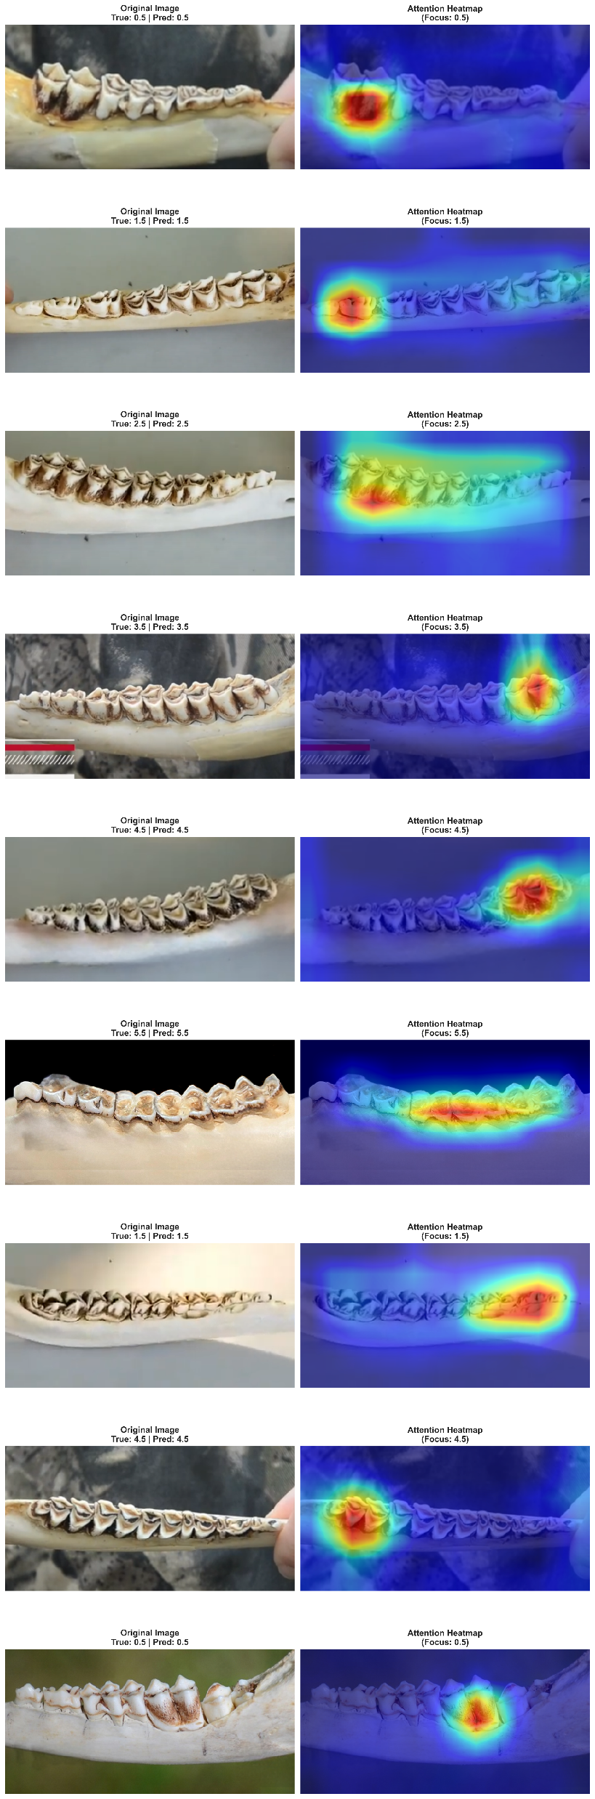

Original image
Attention heatmap
0.5 years
1.5 years
2.5 years
3.5 years
4.5 years
5.5+ years

